Slide 1
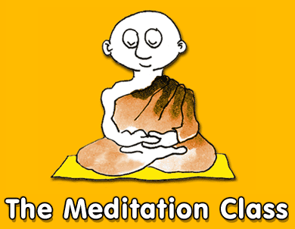
http://www.buddhanet.net/e-learning/medclass

Slide 2
Welcome to the meditation class!
Okay, what are we going to do in this class?
First, get an overview of the basics: the posture, the techniques in sitting and walking meditation. Then you need to become familiar with the awareness and loving-kindness practices.

Slide 3
It is not too difficult really - if you understand what you are doing. You need persistence though, and staying power. Don't worry, I'll walk you through the details of the practice with the help of flow charts, no worries.

Slide 4
While it is necessary to sort out the physical side of the practice and learn the techniques, actually it is really about working with the mind.
Awareness, or Insight Meditation is a practice of being attentive - being alert - to what is happening in your own mind and body, as it is happening. This will lead to insight, understanding of who you are, what it is all about.

Slide 5
To have this level of attentiveness, you need to keep the mind sweet, at ease, and open to the experience. This means you need to have, or develop, loving-kindness as well - and that feels good too.

Slide 6
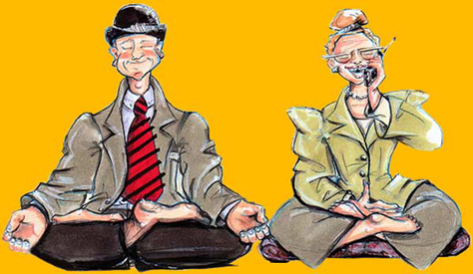
To have this level of attentiveness, you need to keep the mind sweet, at ease, and open to the experience. This means you need to have, or develop, loving-kindness as well - and that feels good too.

Slide 7
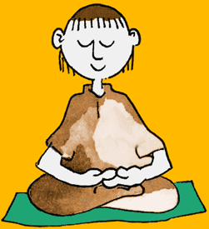
My goodness, this meditator looks as if he knows all about it already, I wonder what is he doing in the class! Maybe he is showing us how to do it - but that is okay. I am here to show you how to do the basics of the sitting and walking meditation. So let us start with some sitting postures . . .

Slide 8
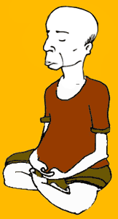
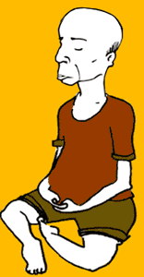
The first posture is easy - no pain! Sit on the edge of a cushion and settle into a comfortable, upright balanced posture. Anchor the attention to the body through the touch sensations of hardness or softness from the body's contact. Relax, relax, relax.

Slide 9
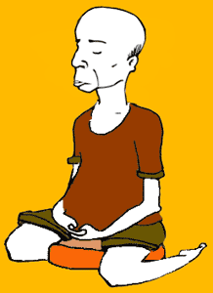
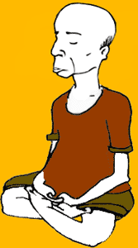
Don't be a martyr, if it all too difficult try the kneeling posture using a cushion or stool. And don't even try the last posture - the full lotus, as you won't last long in it anyway.

Slide 10
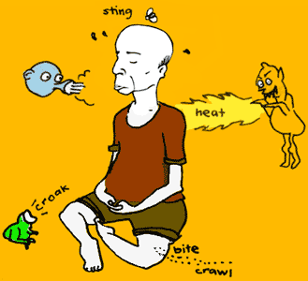
Okay so you've sorted out your posture - now what are you supposed to be doing in the sitting? Well, as you see, there's lots going on - so you'll need to get a handle on it. So we've made some very nice flow charts for you to checkout. They'll put you on the right track. . .

Slide 11
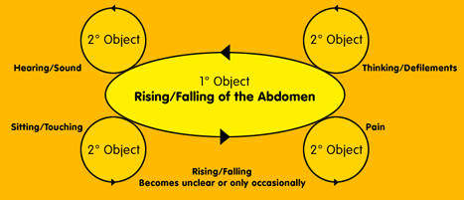
The basic technique here is to establish a 'Primary Focus' on of the 'Rising / Falling' movement of the abdomen by mentally naming or noting this movement. But when a secondary object takes your attention, such as thinking, etc., you must switch and acknowledge or note the new object until it disappears. Only then returning to the 1st or primary object. Just stay in the flow . . .

Slide 12
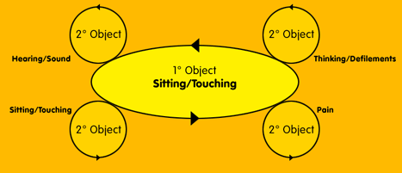
The object of attention will change, here the 'Sitting / Touching' of the body has become the primary focus. So, just be aware of whatever object is strongest - knowing its specific characteristic/s. It is all about investigating the body/mind phenomena, that is - you. Be a witness to your experience, then a natural, non-reactive awareness will develop - no problem.

Slide 13
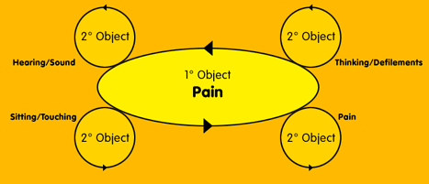
If you sit long enough you will meet your best friend - pain! Don't chase it away as it will teach you its true nature. Know its specific characteristics, such as throbbing, stabbing, tension, heat, etc. Then you will know, like all things, it has the nature to rise and pass away - for sure.

Slide 14
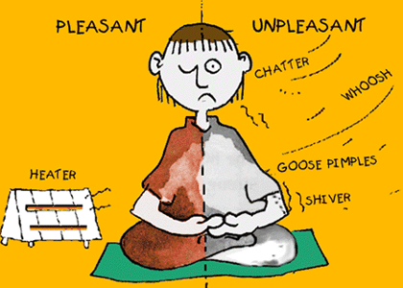
Here's that guy again, really cool - getting into the feelings: 'Pleasant / Unpleasant' - knowing without reacting - brilliant! Just noting: 'knowing only', knowing only', knowing only' . . .

Slide 15
Now we'll try the walking meditation. How to do it? Well, first you find a level track about 15 to 20 paces and walk back and forth noting the parts of the steps in the walking. Don't worry, it's all explained in the diagrams that follow, and there's a flow chart with more instruction as well - we look after you very nicely here.

Slide 16
Start simply by noting the steps: 'right, left', 'right, left' for the first five minutes of so, until you settle.
Then mentally note the parts of the steps: 'lifting', 'placing', concurrent with the experience the of movement.
Slow down and keep a relaxed, but alert awareness as you note the 'lifting', 'pushing', placing.

Slide 17
There's a lot of feet here - don't worry, just keep noting: 'raising', 'lifting', 'pushing', 'placing'.
Feel into the movement, relax the foot as you carefully note the five parts to the step.
This is the lot: the six component parts: - noting 'raising' , 'lifting', 'pushing', 'dropping', 'touching', 'pressing'.

Slide 18
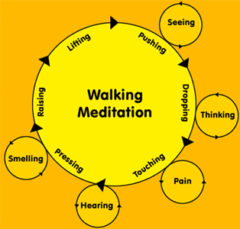
Follow the flow chart: noting the parts of the step and if secondary objects take your attention acknowledge them as well. To keep the balance in the practice alternate between the sitting and walking meditation. Try 1/2 to 1 hour sitting followed by a 1 hour walking session - keeping up a nice flow of awareness. For the practice to deepen - continuity is the key, you've got to keep at it.

Slide 19
Follow the flow chart: noting the parts of the step and if secondary objects take your attention acknowledge them as well. To keep the balance in the practice alternate between the sitting and walking meditation. Try 1/2 to 1 hour sitting followed by a 1 hour walking session - keeping up a nice flow of awareness. For the practice to deepen - continuity is the key, you've got to keep at it.

Slide 20
How to do loving-kindness meditation
Now we can do a meditation that helps sweeten and calm the mind. You begin with developing loving acceptance of yourself. If resistance is experienced then it indicates feelings of unworthiness are present. No matter, this means there is work to be done, as the practice itself is designed to overcome any feelings of self-doubt and/or negativity.

Slide 21
Then you are ready to develop loving-kindness to others. Four types of persons are chosen to send loving-kindness to:
• A respected, beloved person - such as a spiritual teacher;
• A dearly beloved person - a close family member or friend;
• A neutral person - somebody you know, but have no special feeling towards, for example: a person who serves you in a shop;
• A hostile person - someone you are currently having difficulty with.

Slide 22
Starting with yourself, then moving systematically from person to person in the above order will have the effect of breaking down the barriers between the four types of persons and yourself, at the same time breaking down the divisions within your own mind. Try different people to practice on as some people do not easily fit into the above categories, but do keep to the prescribed order.

Slide 23
Ways of arousing feelings of loving-kindness:
Visualising, that is, have a mental picture of yourself, or the person you have chosen, in a happy state of mind.
Reflecting on the positive qualities of a person and the acts of kindness they have done; and to oneself, make and repeat an affirmation, i.e. a positive statement about yourself.
Auditory, while this is the simplest - it can be the most effective method. It is repeating an internalise mantra or repetition of a word or phrase such as 'loving-kindness'.

Slide 24
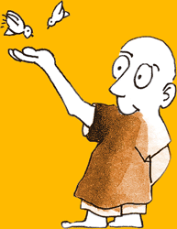
Loving-kindness meditation (continued)
The visualisation, reflections and the repetition of loving-kindness are devices to help you arouse positive feelings. You can use all of them or one that works best for you. When the positive feelings arise switch from the devices to the feelings, as it is the feelings that are the primary focus. Keep the mind fixed on the feeling, if it strays bring it back to the device or if the feeling weakens or is lost then return to the device, for example, use the visualisation to bring back or strengthen the feeling.

Slide 25
The second stage is 'Directional Pervasion' where you systematically project the aroused feeling of loving-kindness to all points of the compass: north, south, east and west, up and down, and all around. This directional pervasion can be enhanced by bringing to mind friends and communities in the cities, towns and countries around the world.

Slide 26
Non-specific pervasion follows, which tends to spontaneously happen as the practice matures and is not discriminating. There is no specific object but just naturally radiating feelings of universal love. The practice has then come to maturity in that it has changed particular love, preferential love, which is an attached love to an all-embracing, unconditional love!

Slide 27
Loving-kindness is a heart meditation and should not be seen as just a formal sitting practice removed from everyday life. So take your good vibes outside into the streets, at home, at work, into your relationships. Applying the practice to daily life is a matter of directing a friendly attitude toward everybody you come into contact with.
May you be happy hearted!

Slide 28
Loving-kindness is a heart meditation and should not be seen as just a formal sitting practice removed from everyday life. So take your good vibes outside into the streets, at home, at work, into your relationships. Applying the practice to daily life is a matter of directing a friendly attitude toward everybody you come into contact with.
May you be happy hearted!

Slide 29
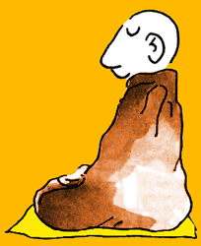
There's no way around it friends - meditation requires practice, that is, repeated performance to develop the skill. So it's up to you to do the practice, eh. If you wish, go over these instructions again and again until you feel that you have integrated them. Then it is just practice - happy meditating!

Slide 30
http://www.buddhanet.net/e-learning/medclass

